Slide 1

Basic Details of the Team and Problem Statement
Ministry/Organization Name/Student Innovation:
PS Code: 116
Problem Statement Tittle: Self –Identifying the mental health status and get guidance for support
Team Name: TRIAL BLAZERS
Team Leader Name :SWEDHA V
Institute Code (AISHE):1133
Theme Name:

Slide 2
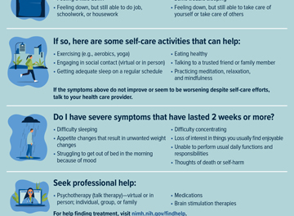
Idea/Approach Details
Add process flow chart or simulated image of prototype or any relevant image related to your idea
Describe your idea/Solution/Prototype here:
Self identifying mental health status and get guidance for support-fitness.
Describe your Technology stack here:
Frontend Development
Backend Development
Authentication and Security
Data Storage and Analytics
Machine Learning and AI
Mobile App Development Tools
User Experience (UX) and User Interface (UI) Design

Slide 3
Idea/Approach Details
Describe your Use Cases here
Describe your Dependencies / Show stopper here
Online Support Groups and Communities
Mental Health Workshops and Webinars
Therapeutic Exercise Classes
Crisis Helplines and Chat Services
Mental Health Assessment Tools
Mobile Apps for Self-Care
Peer Support Programs
Art and Expressive Therapy
Mental Health Education in Schools
Employee Wellness Programs
Feeling a little down
Feeling down, but still able to do job, schoolwork, or housework
Some trouble sleeping
Feeling down, but still able to take care of yourself or take care of others
In such cases , self analysis of mental health is mandatory.

Slide 4
Team Member Details
Team Leader Name : SWEDHA V BE.ECE III YEAR
Team Member 2 Name: PIRIYADHARSHINI E BE.ECE III YEAR
Team Member 3 Name: NIVETHA S BE.ECE IIIYEAR
Team Member 4 Name: KEERTHIKA M BE.ECE III YEAR
Team Member 5 Name: DEVIKA S BE.ECE III YEAR
Team Member 6 Name: SARANYA S BE ECE III YEAR
Team Mentor 1 Name: DR.G SHANMUGARAJ Expertise (AI/ML/Blockchain etc): Domain Experience
Category (Academic/Industry): Expertise (AI/ML/Blockchain etc): Domain Experience (in years):

